Slide 1




DBMS PROJECT
RESUME MAKER
Submitted To: Hira Siddiqui
PRESENTED BY:
PRIYA NAND FA21-BSSE-0052
DANIYAL MEGHWAR FA21-BSSE-0050
SIDRA SHEIKH FA21-BSSE-0031
AYESHA JAWAID FA21-BSSE-0010

Slide 2

welcome
Sign up
CV MAKER
Sign in
PAGES
Search page
Resume generate

Slide 3

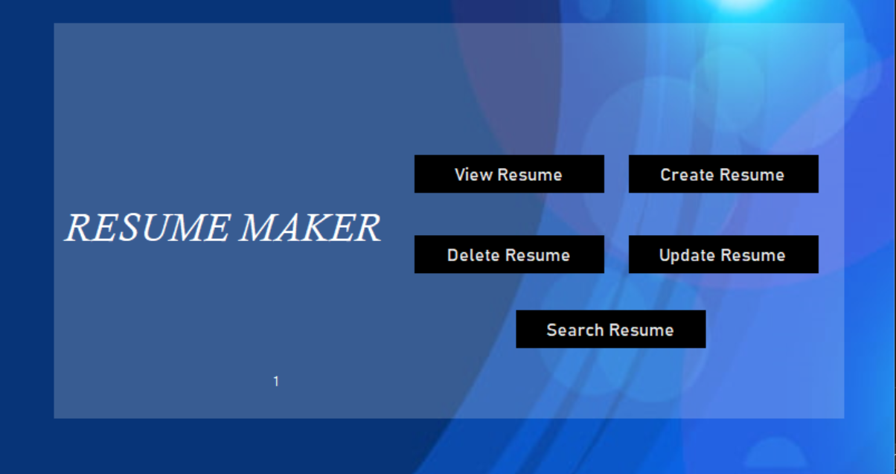
Main page

Slide 4
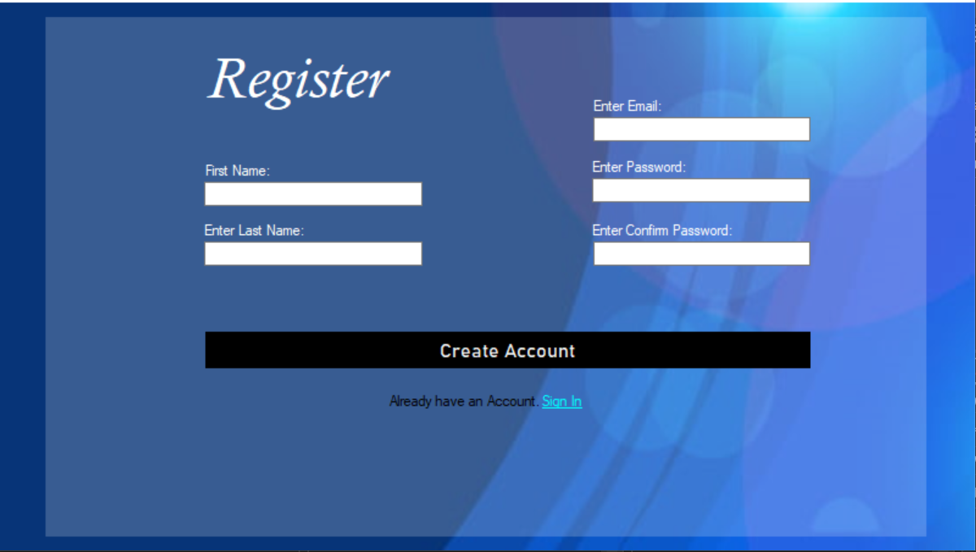
Sign up

Slide 5
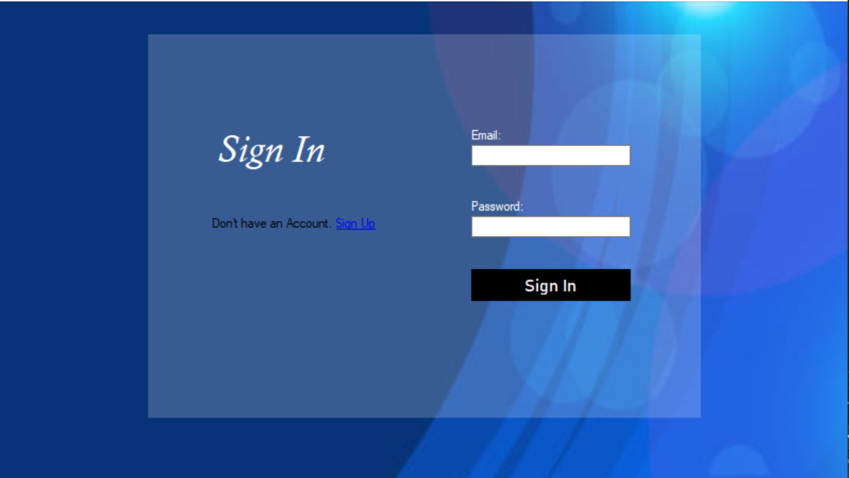
Sign In

Slide 6
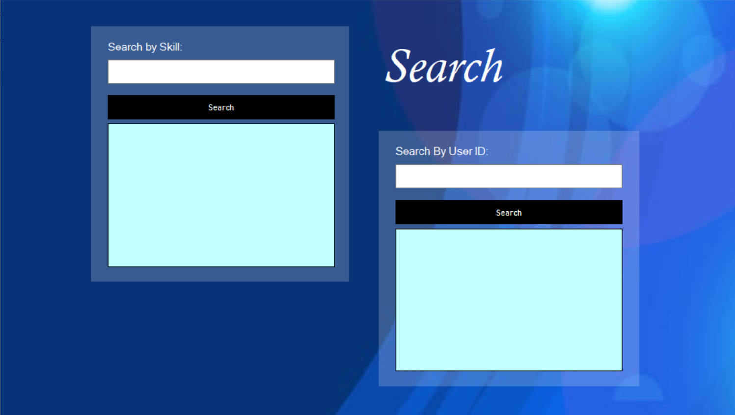
Search page

Slide 7
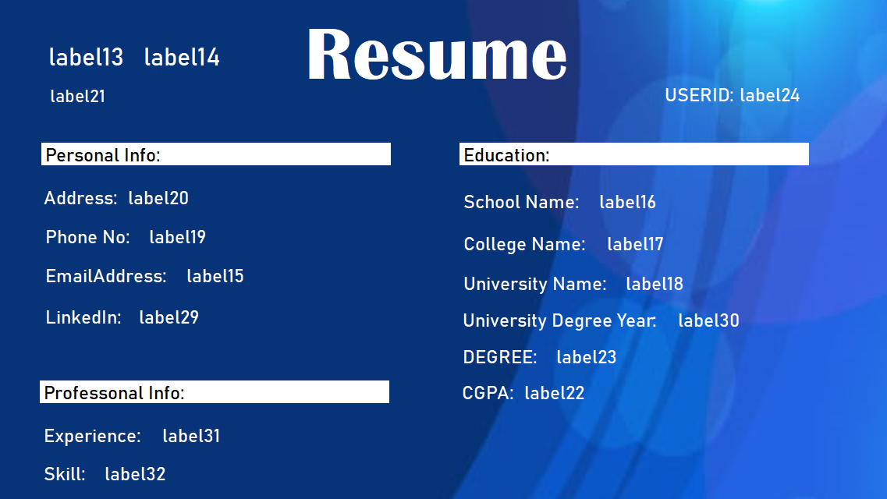
Resume Generate page

Slide 8
THANK YOU

